Slide 1
ABSTRACT
The Bookstore management system database effortlessly integrates all components related to a book store. Bookstore management system mainly focuses on the activities of a book store such as information on books and stocks left. The database flexibility, convenient features, the maximum increase in customer service, access to accurate information make this ideal for all sizes of book stores. This paper discusses about why the book store needs to collect and manage information about books, publishers. The Book store management system is used for analyzing the books information, stocks, and when necessary to produce reports.

Slide 2
PURPOSE
The Book store management system is the primary source for operating bookstore activities. At present, all the record books is done manually in the account books, which is moderate, time consuming process, takes more manpower, and chances of errors is more. Therefore, it is better to design a Computerized Automated Book Store System to increase the speed of stock checking, access book details and cost of the book. It makes simple to use the system.

Slide 3
FACILITIES TO BE PROVIDED TO THE USER
User can choose any kinds of books easily from this project.
User can search any kind of books from this project.
User can add, update the contents.

Slide 4
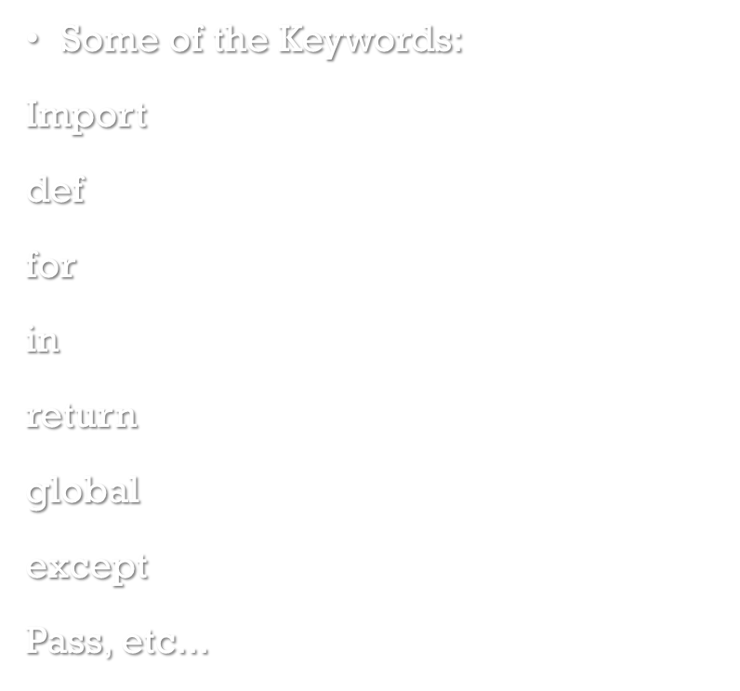
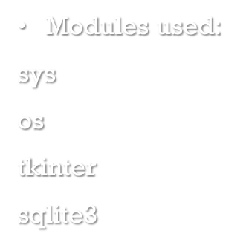
KEYWORDS AND MODULES

Slide 5
SOFTWARES USED
Python idle – for the front and backend
Sqlite3 manager – it is used as the database management system
Firefox browser - it is used for opening the sqlite3 manager

Slide 6
HARDWARE REQUIRED
Some Minimum System Requirements
Processor: Pentium 13 Processor.
Hard disk: 500 GB.
Monitor: Standard LED Monitor
Input Devices : Keyboard, mouse
Ram : 4 GB

Slide 7
PROPOSED SYSTEM
It is an automated Bookshop Management System. Through our software user can add books, search books, update information, delete information and search information. Our proposed system advantages. has the following
It provides "better and efficient" services to members.
Reduce the workload of employee.
Faster retrieval of information about the desired book.
Provide facility for proper monitoring reduce paper work
All details will be available on a click.
It has more storage capacity and search facility and fast access to database. All the manual difficulties in managing the Bookshop have been rectified by implementing computerization.

Slide 8
FUTURE SCOPE
This software can be easily implemented under various situations. Any education institute can make use of it for providing information about author, content of the available books in their library. Modifications can be easily done according to requirements and when necessary. It can be used in any type of Book Shop for managing all the sales and purchased activities and managing the data records related to Book house.

Slide 9
CONCLUSION
Bookstore management system report in python is an attempt to overcome the present in efficient and time consuming process of managing the records of books. Through automated book shop solution, provide an easy way of searching and adding of books. It's worth analysing and identifying the benefits as it would directly influence the productivity of the shop.

Slide 10
Thank you

